Slide 1
Prediction of Body-Fat Percentage: A Multiple Regression Analysis
Drew Lindberg
Oluwafunke Folarin
IAF 602 Statistical Methods for Data Analytics
December 2, 2020

Slide 2
AGENDA
Introduction
Methodology
Data Analysis
Results
Limitations and Conclusion

Slide 3
INTRODUCTION
Background Rationale
The efficient functionality of the human body depends on the balanced body fat.
Statement of the problem
Many expensive and time-consuming techniques available to measure body fat
These methods are costly, and are typically limited to research settings
Measurements like waist circumference, sagittal abdominal diameter, and waist-hip ratio are often correlated with body fat percentage and health outcomes
Purpose of the study
It is worth considering other body parts such as:
neck, chest, hip, thigh, knee, ankle, bicep, forearm, or wrist
Research Question
Is there a linear relationship between body fat percentage and the measurement of: neck, chest, hip, thigh, knee, ankle, bicep, forearm, or wrist?

Slide 4
METHODOLOGY
Rationale for a Multiple Regression Analysis
Used to provide the linear relationship among body-fat percentage and measurements of different body parts
Data Description
Dataset contains 250 randomly selected men of varying ages
Data and Story Library (DASL)
Data Analysis Procedure
Correlation and Direction of the Data
Explored dataset to visualize and identify a list of potential predictive variables
checked relationship between each predictor variable and the target variable using
split data into Test and Train datasets
Model Formulation
purposeful selection,
best subset selection and
stepwise selection
Model Evaluation and Validation
Test data was used to predict percent body fat based on the model generated in the training data.

Slide 5
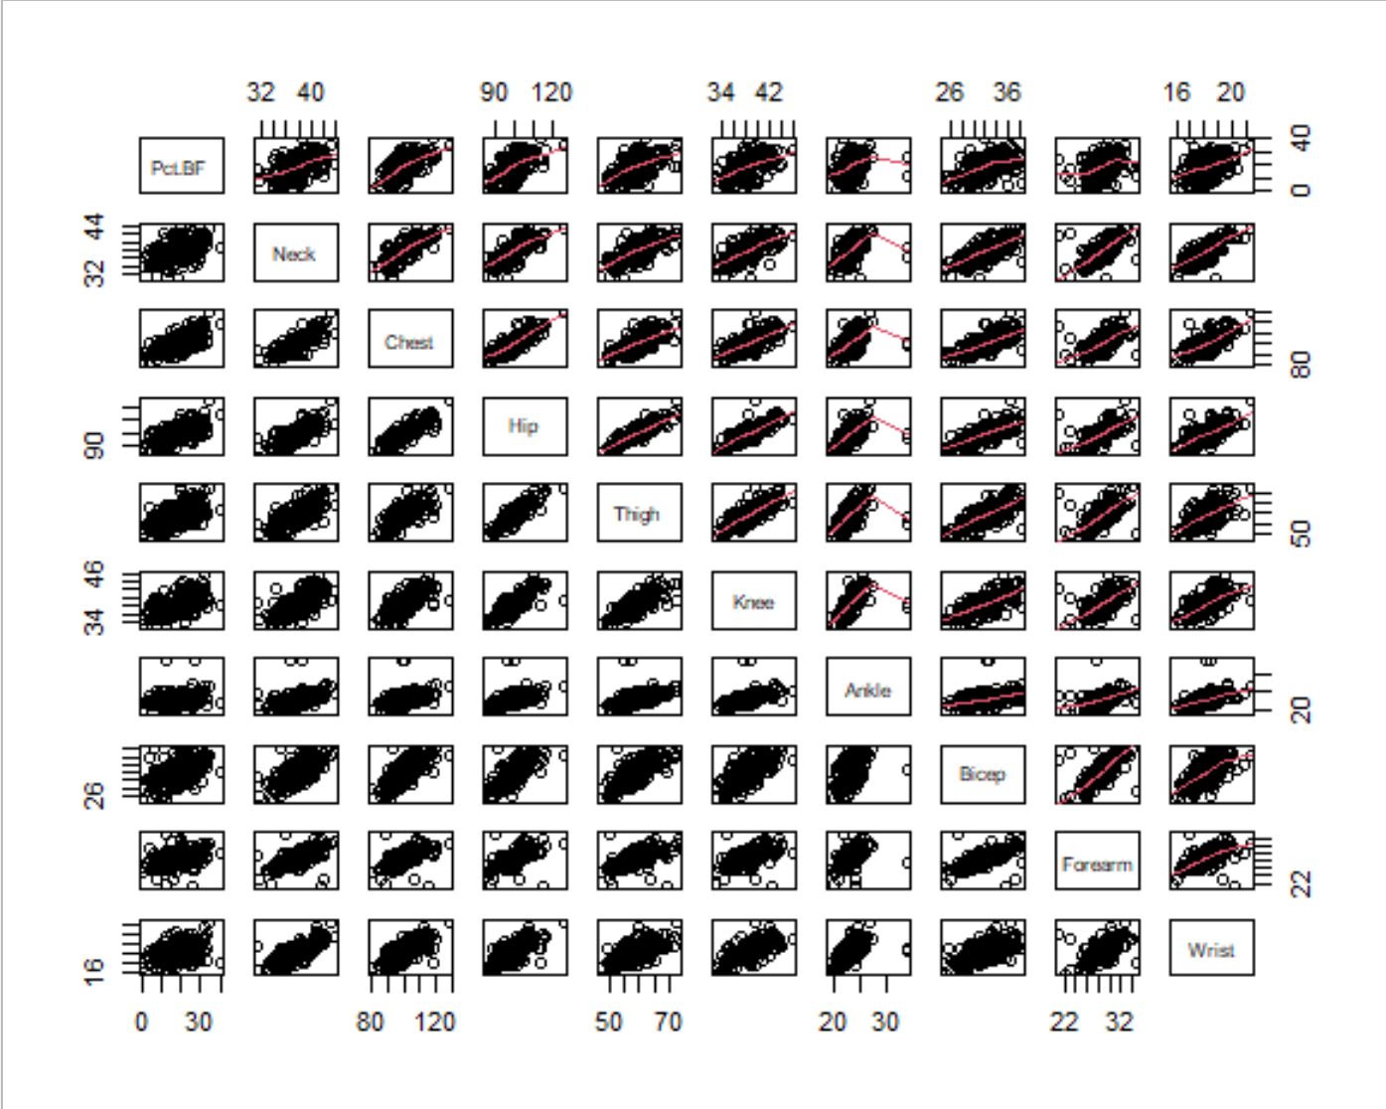
Exploration

Slide 6
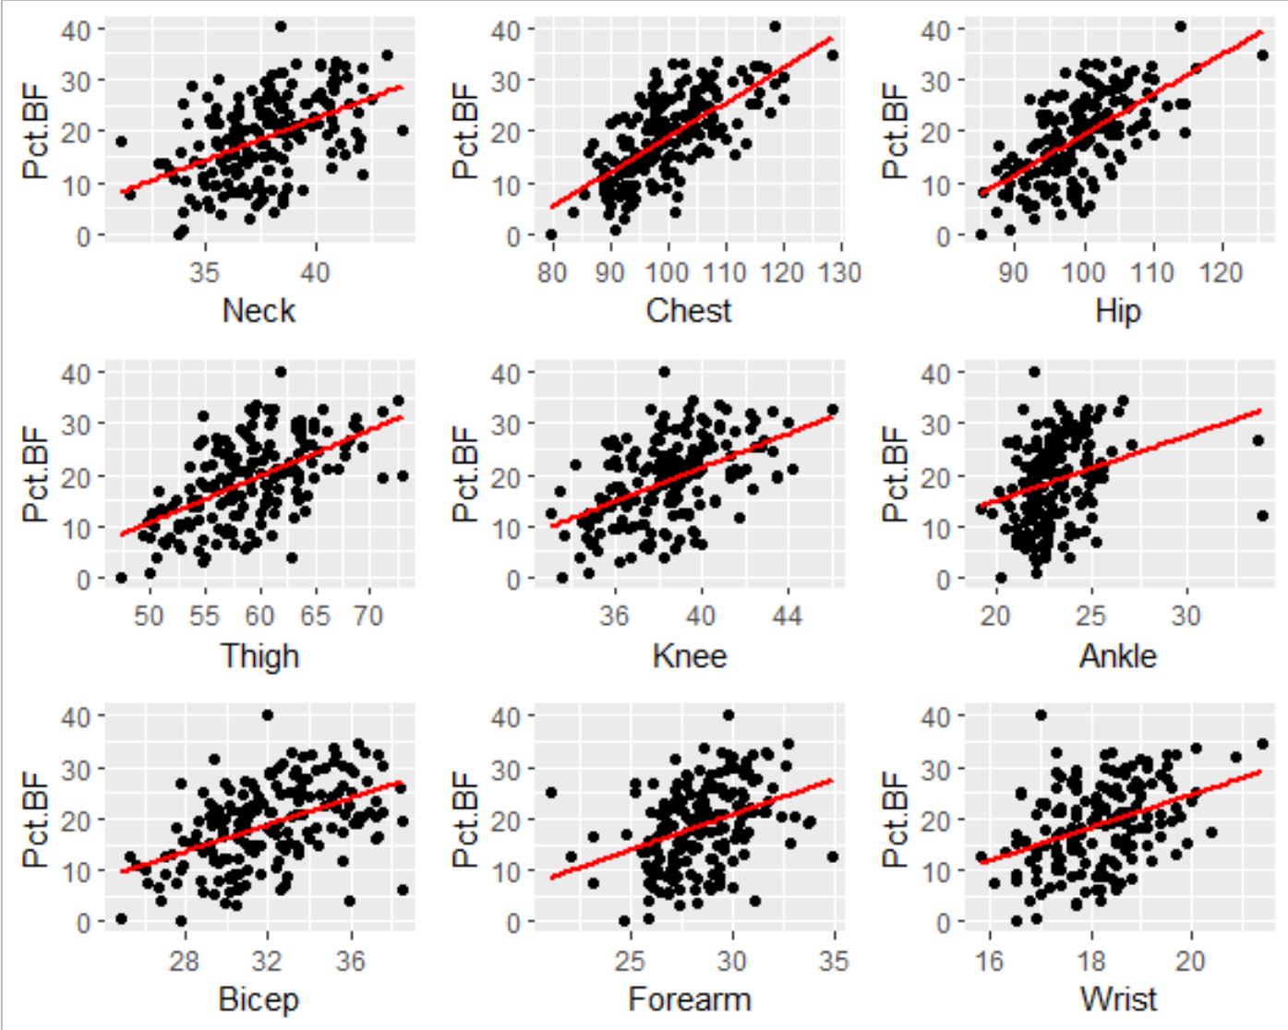
All seem to have linear correlation with the dependent variable
Exploration

Slide 7
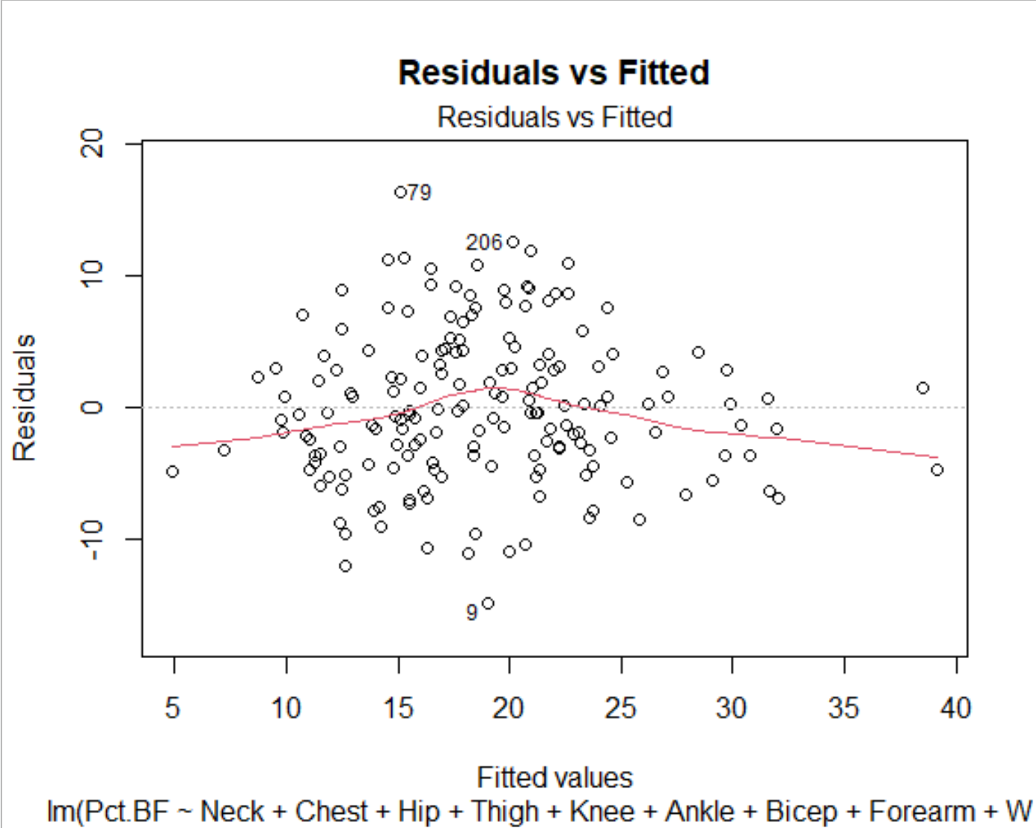
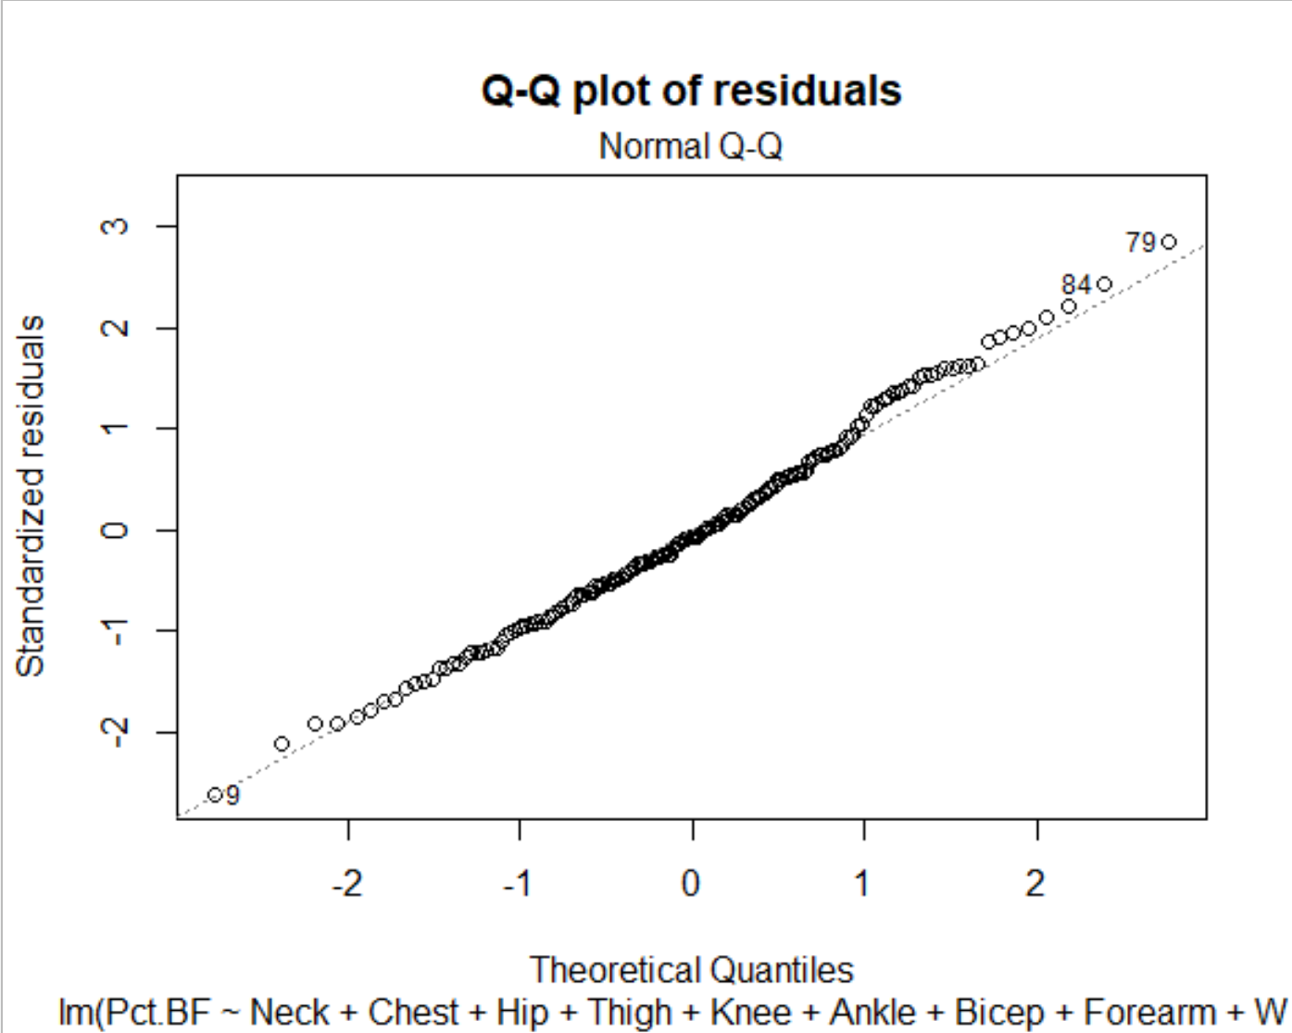
Exploration

Slide 8
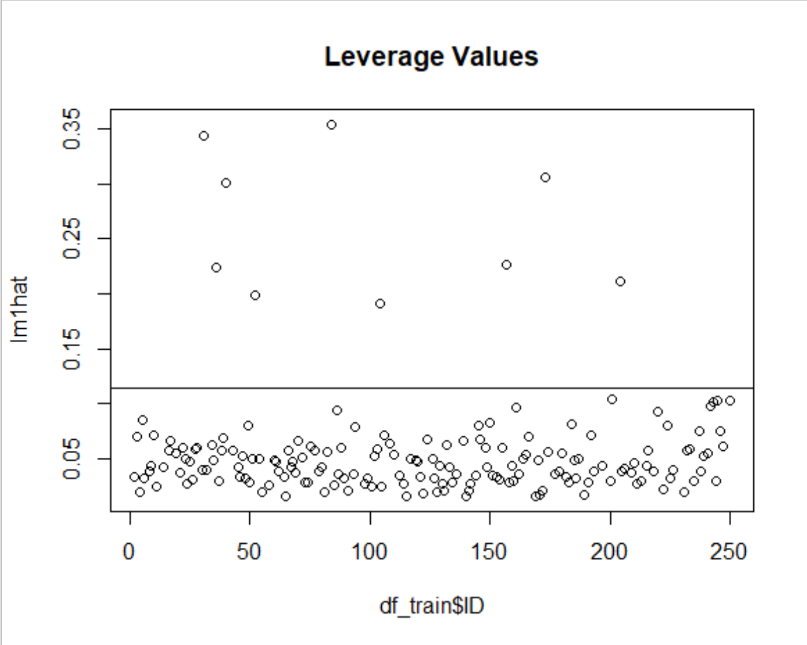
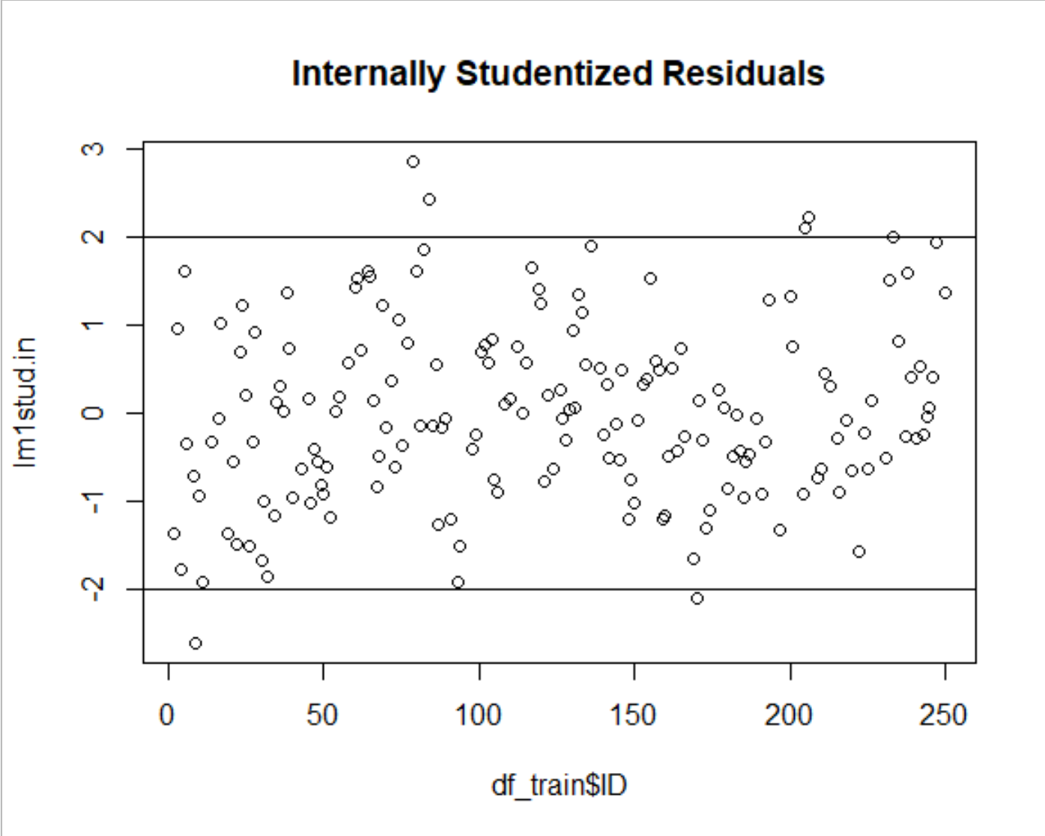
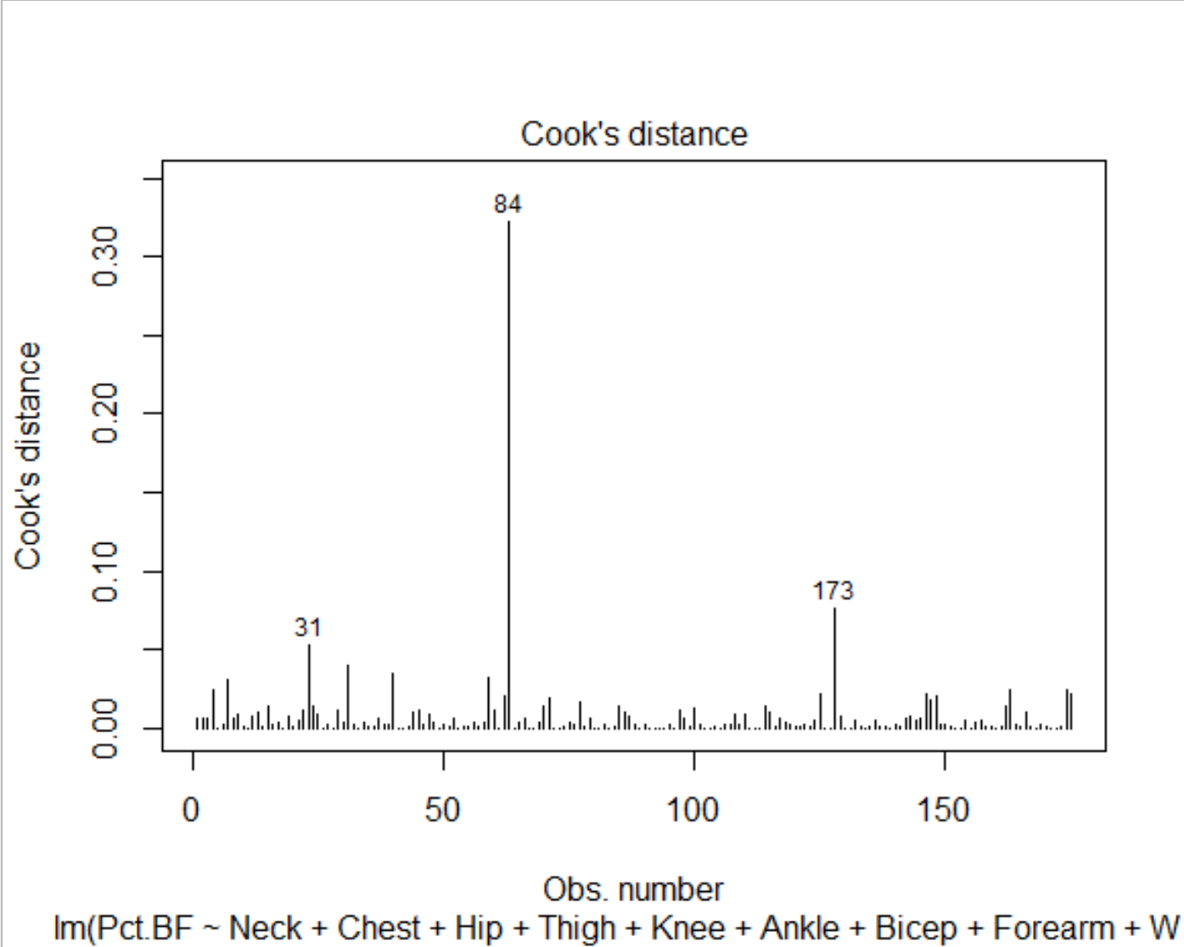

Influential Observations

Slide 9
Influential Observations
Observation | Reported Pct.BF | Expected Pct.BF | Finding
9 | 4.1 | 18.97 | 4.1 Pct.BF is an outlier and other measures are larger by comparison to other observations with a similar Pct.BF.
180 | 0 | N/A | Observation has 0 Pct.BF which is not possible.
31 | 11.9 | 19.4 | Observation has an exceptionally large ankle measurement given the low weight.
36 | 40.1 | 33.4 | Observation has an exceptionally high Pct.BF. Other observations with large Pct.BF have larger weight and waist.
40 | 34.5 | 41.0 | Observation has large measurements for all measures.
52 | 6.3 | 18.9 | Observation has a small hip and thigh but a large bicep and forearm. Pct.BF given weight seems accurate. Subject should probably stop skipping leg day.
79 | 31.4 | 29.3 | Observation has a very large Pct.BF given a relatively low weight and average height.
84 | 26.6 | 30.1 | Observation has a very large ankle measure especially given the average measures for everything else.
104 | 18.0 | 23.4 | Observation has a peculiar neck measurement.
157 | 12.5 | 15.1 | Observation has an exceptionally large ankle measurement.
170 | 0.7 | 16.6 | Observation has an exceptionally low Pct. BF
173 | 25.3 | 29.2 | Observation has a low Pct.BF given the high measurements elsewhere
204 | 16.6 | 27.0 | Observation has a low Pct. BF given the high weight, neck, chest, and abdomen measures.
205 | 32.9 | 26.6 | Observation has a high Pct.BF given the low weight.
206 | 32.8 | 25.9 | Observation has a low weight given the high Pct.BF and high measures elsewhere.
233 | 25.8 | 26.8 | Observation has a low weight given the Pct.BF.

Slide 10
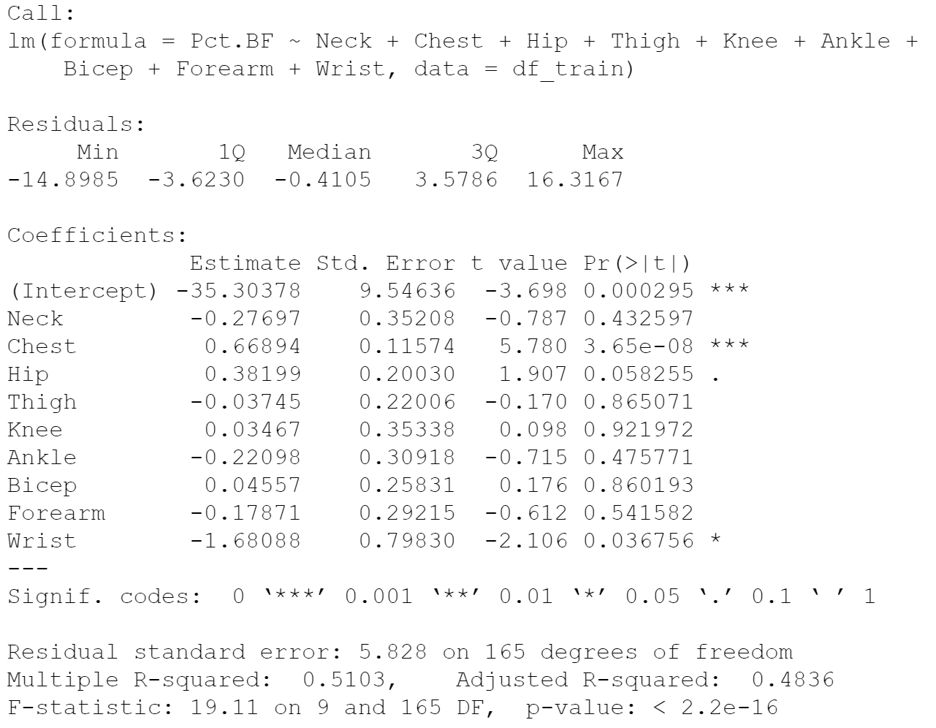
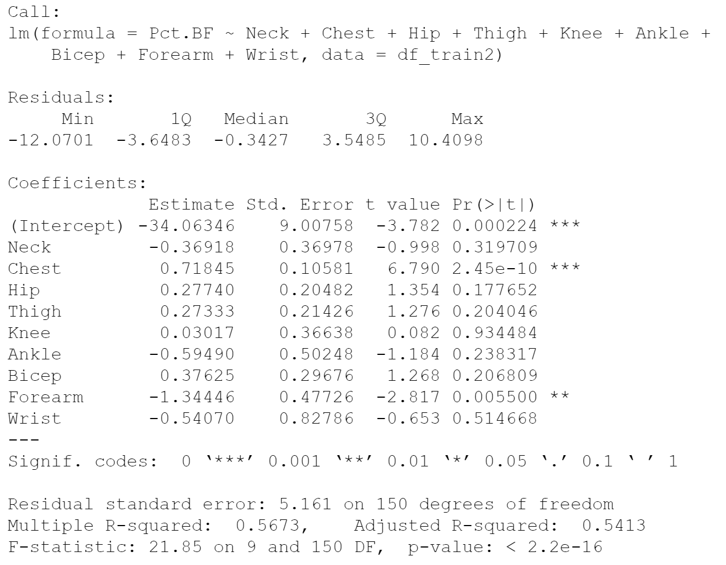
Influential Observations
With Outliers
Outliers Removed

Slide 11
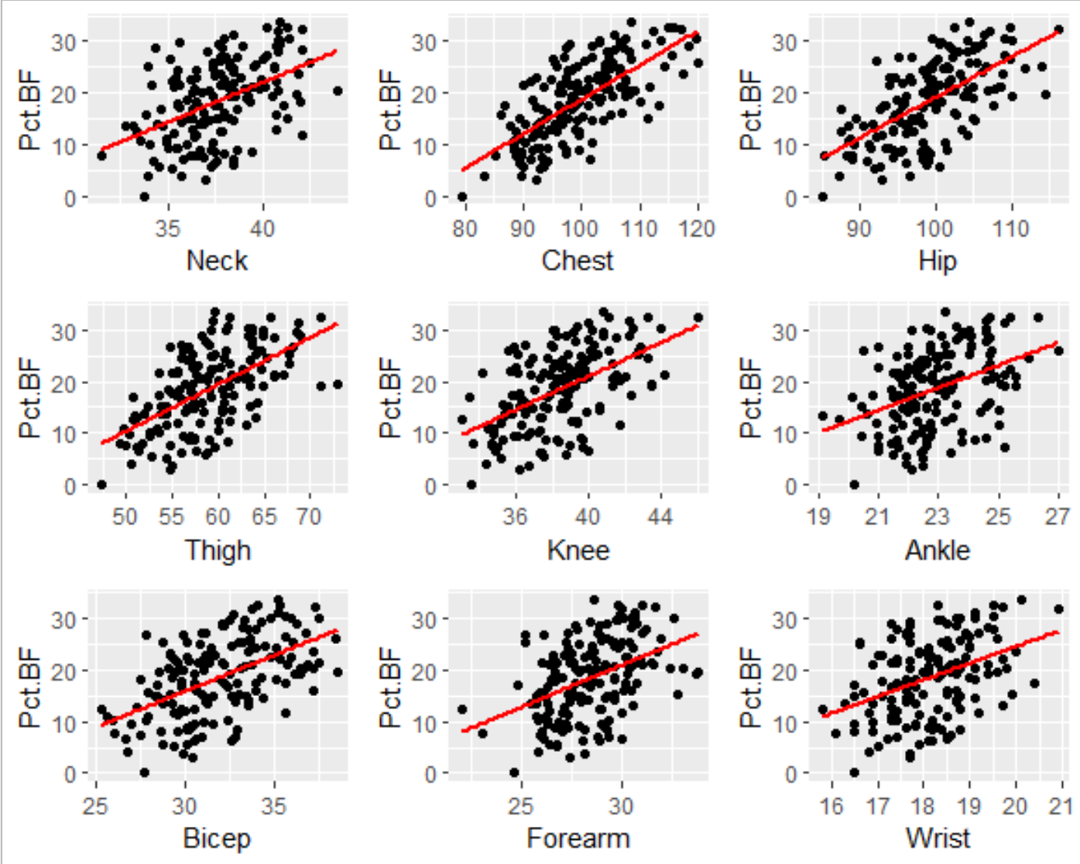
Influential Observations

Slide 12
Variable Selection Strategies
-Purposeful
-Stepwise Elimination Using AIC
-Best Subset using BIC and Malow’s Cp

Slide 13
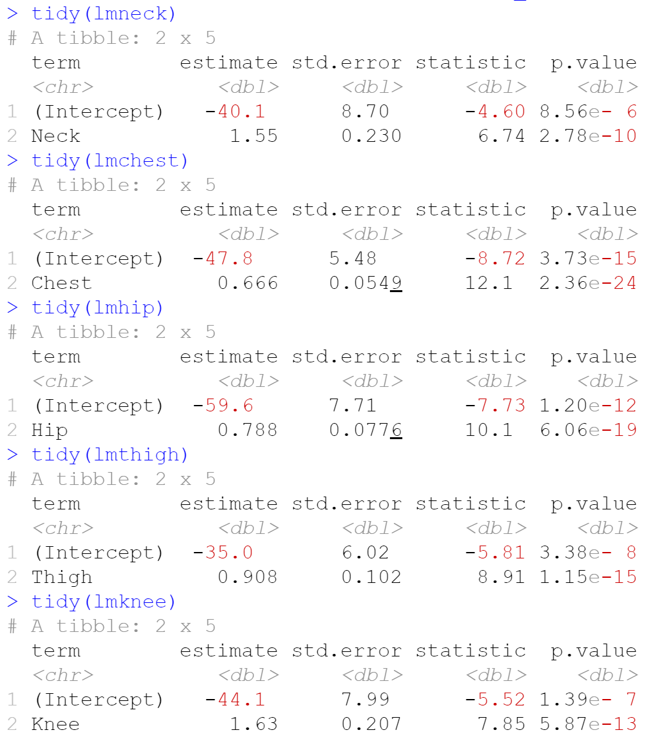
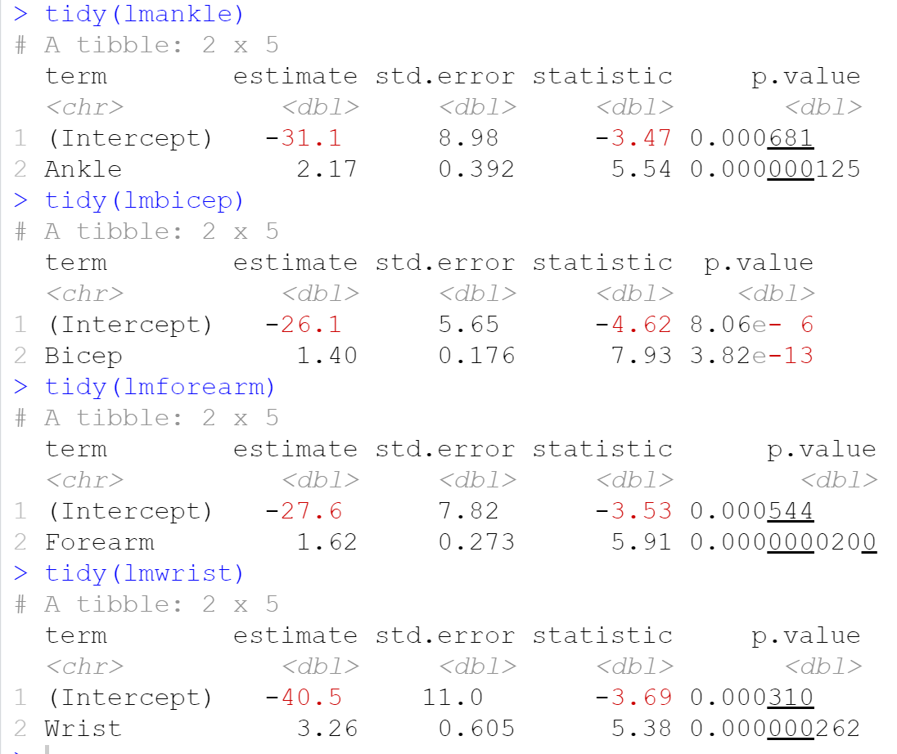
Purposeful Selection

Slide 14
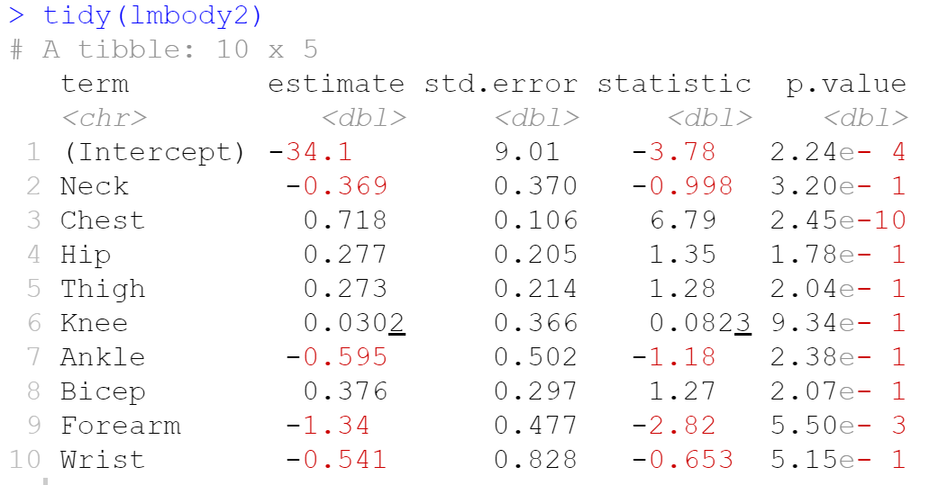
Purposeful Selection

Slide 15
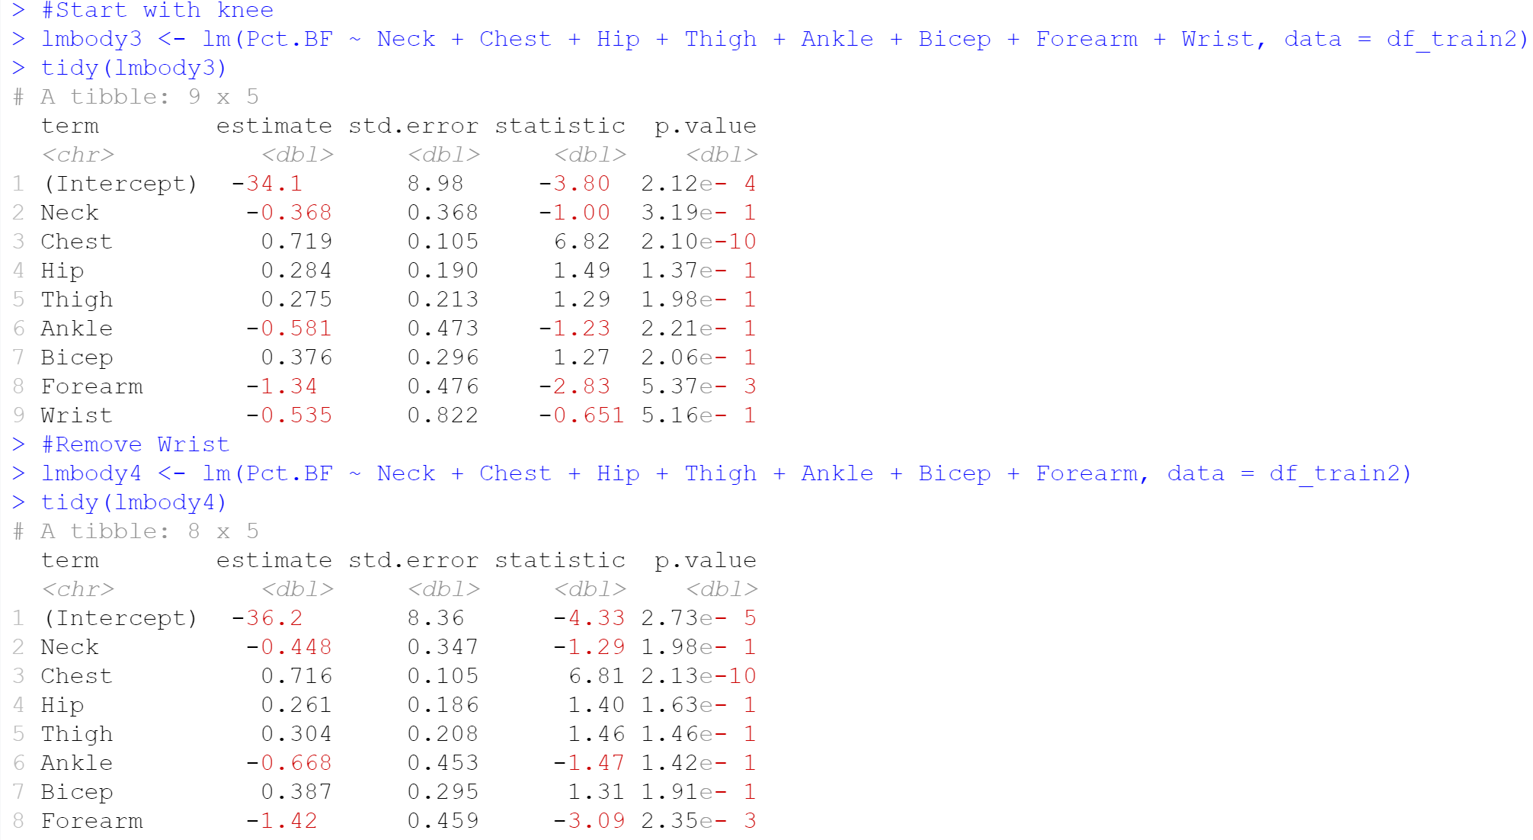
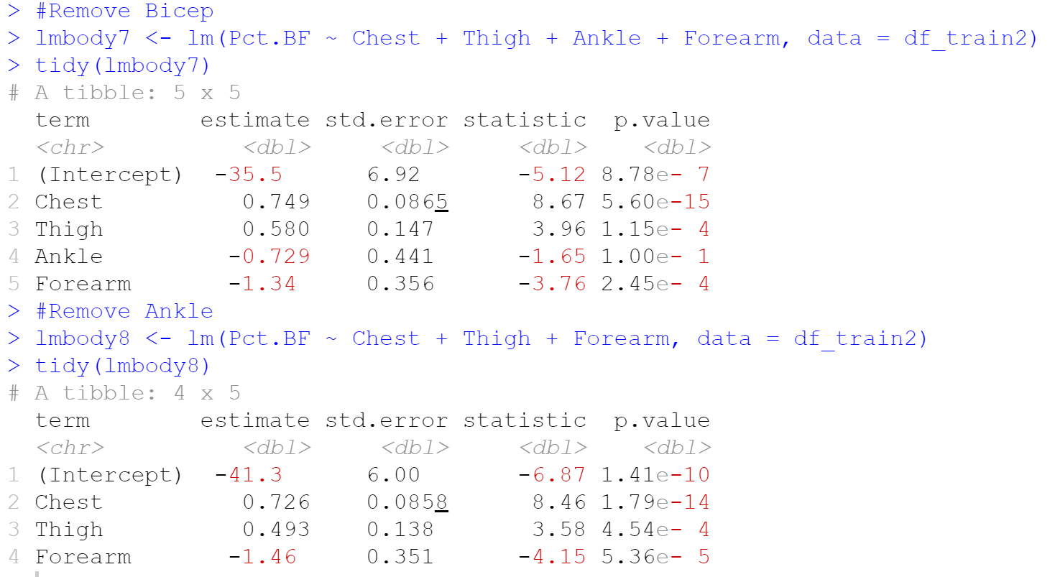
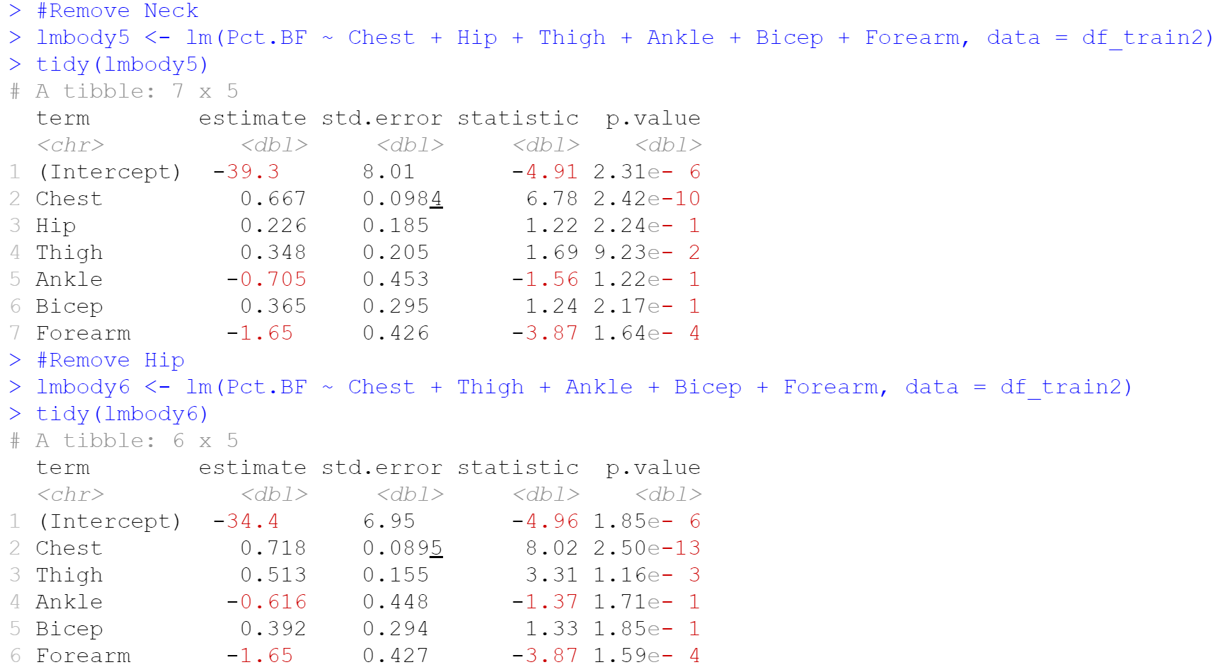
Purposeful Selection

Slide 16
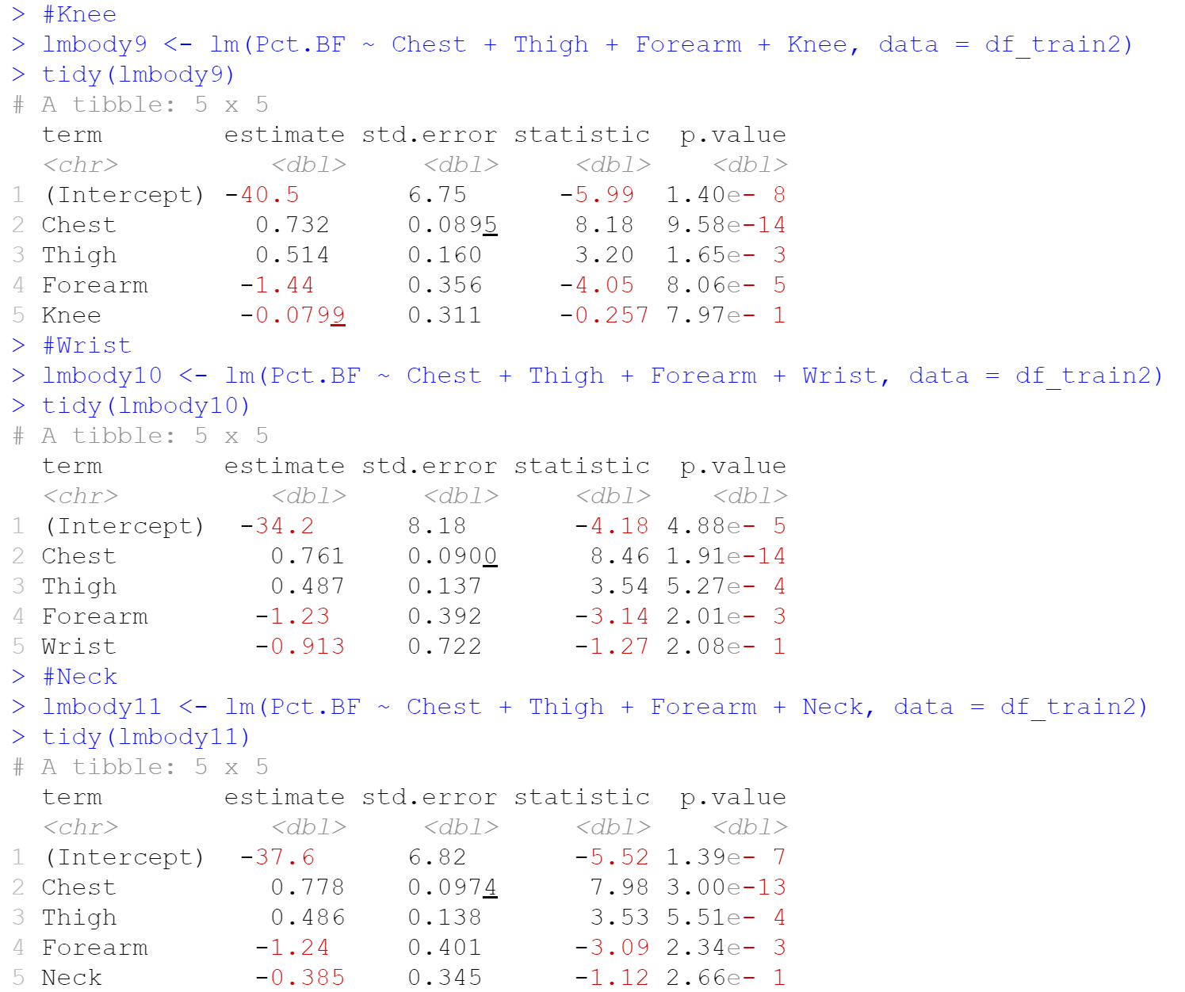
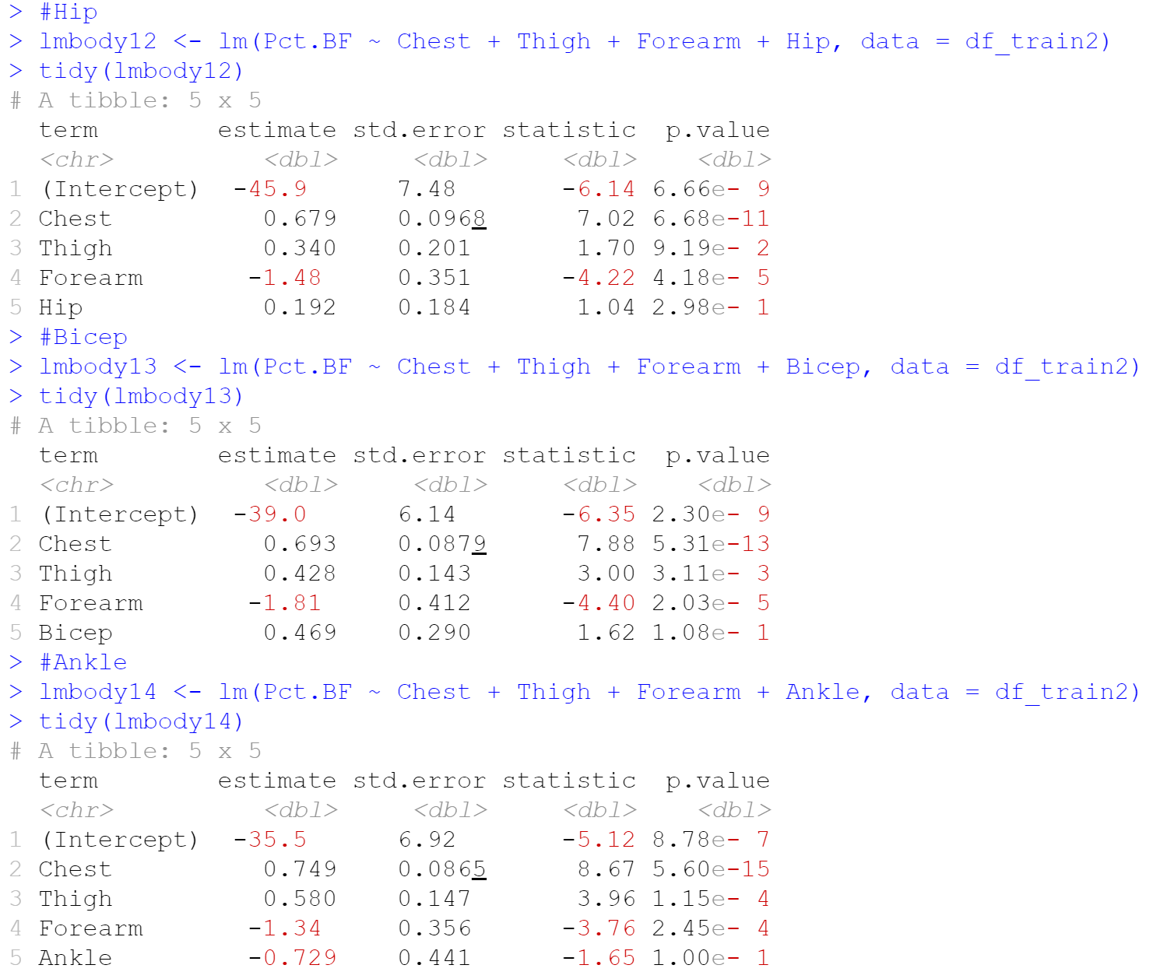
Purposeful Selection
p = 0.10 Could be debatable…?

Slide 17
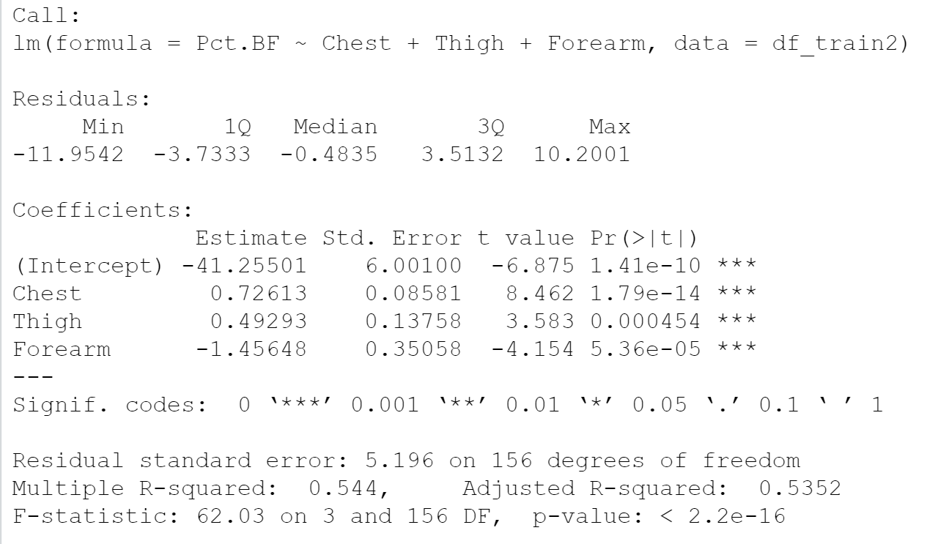
Purposeful Selection

Slide 18
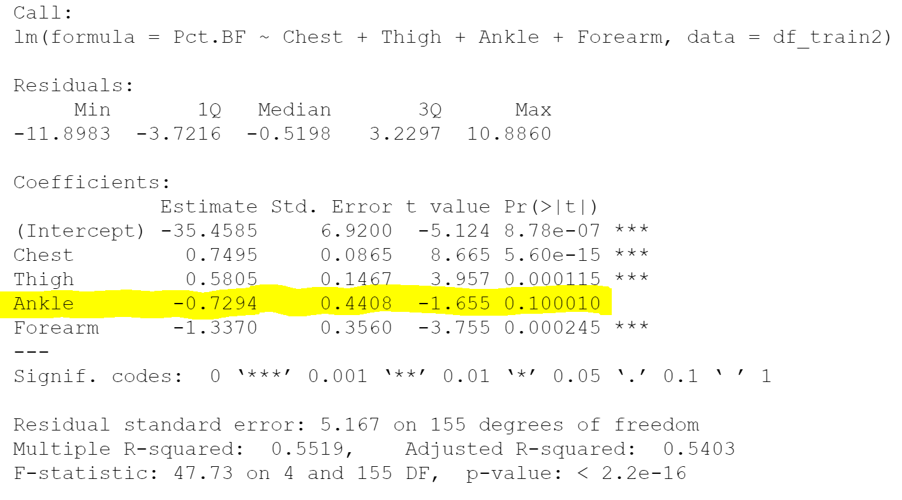
Stepwise Elimination

Slide 19
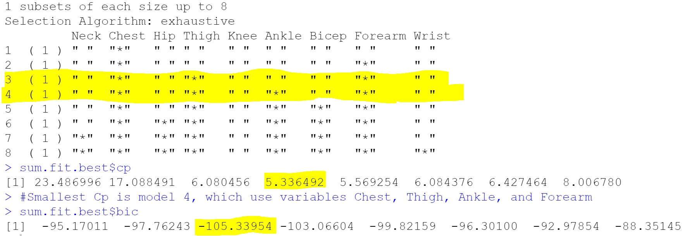
Best Subset Selection

Slide 20
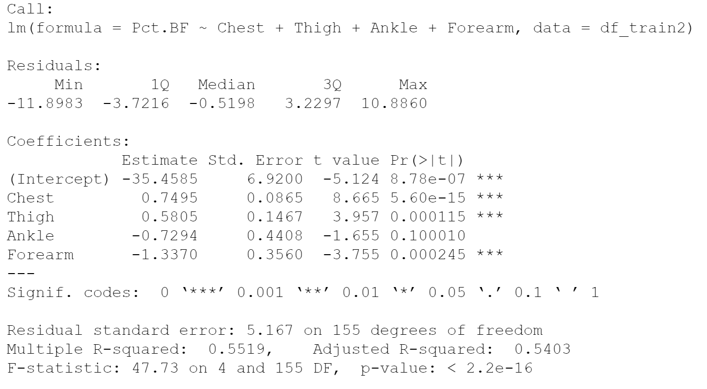
Two Competing Models
3 Variables, excluding Ankle
4 Variables including Ankle
Purposeful BIC
Stepwise
Mallow’s Cp

Slide 21
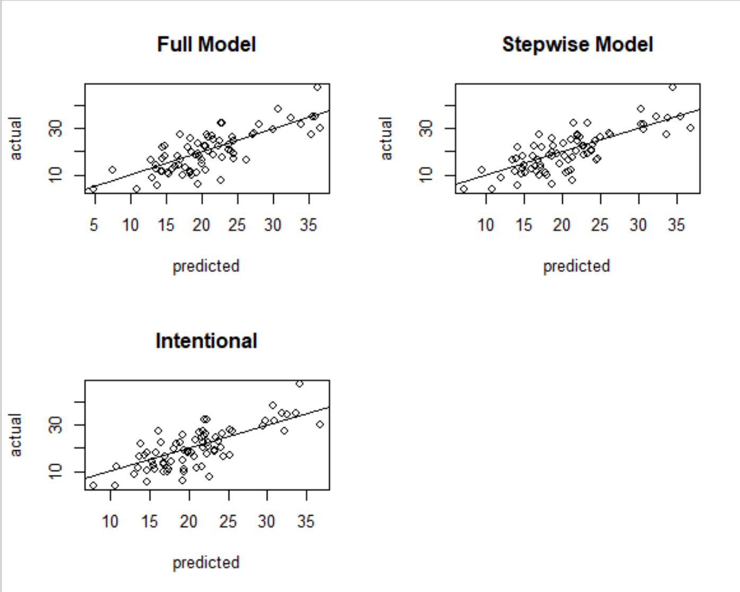

Model Selection
RMSE = 5.59
RMSE = 5.53
RMSE = 5.67

Slide 22
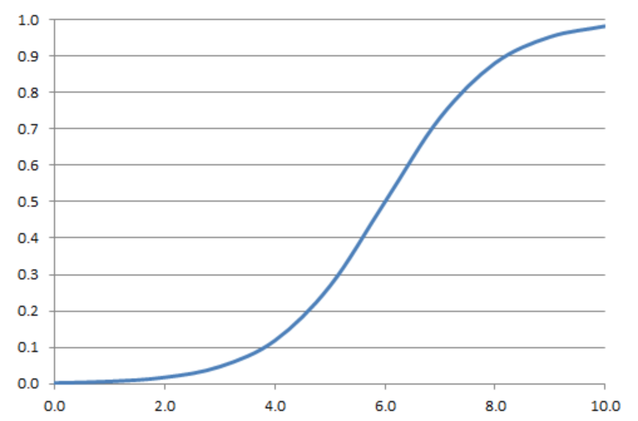
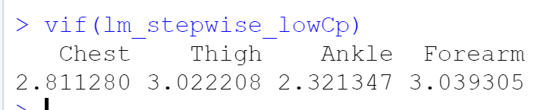
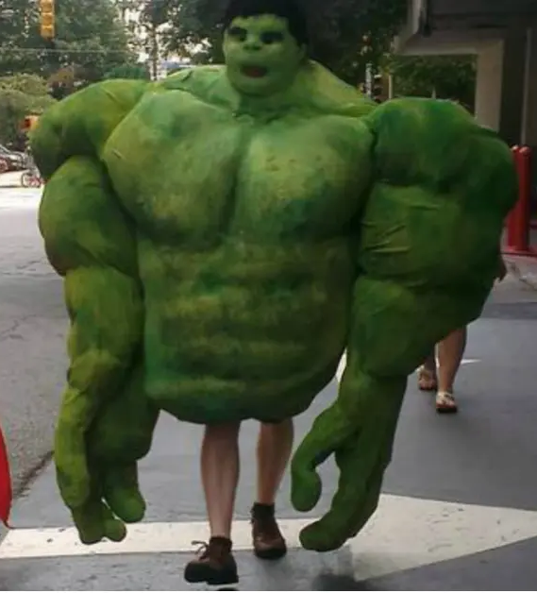
Limitations
Multicollinearity
Would a different model be more appropriate?
Correlation coefficients operate under the assumption that all other variables are held constant
Dependent variable is a percentage

Slide 23
Conclusions
Is there a linear relationship between percent body fat and the measure of the following body parts: neck, chest, hip, thigh, knee, ankle, bicep, forearm, or wrist?
H₀: There is not a linear relationship between percent body fat and the measures of neck, chest, hip, thigh, knee, ankle, bicep, forearm, or wrist.
Adjusted R²: 0.54
p < 0.01
More research is necessary.

Slide 24
REFERENCES
American Diabetes Association. “2. Classification and Diagnosis of Diabetes.” Diabetes Care. American Diabetes Association. (2015).
Retrieved from: https://care.diabetesjournals.org/content/38/Supplement_1/S8.
Brazzier, Y. (2017, August 16). Body mass index (BMI): Is the formula flawed? Retrieved October 29, 2020, from
https://www.medicalnewstoday.com/articles/255712
CalculatorSoup (2020). Retrieved on October 29, 2020, from BMI Calculator (Body Mass Index) (calculatorsoup.com)
Lindberg, Sara. “Ideal Body Fat Percentage: For Men and Women,” August 16, 2019. Retrieved from:
https://www.healthline.com/health/exercise-fitness/ideal-body-fat-percentage.
“Obesity and Overweight.” World Health Organization. World Health Organization. Accessed September 28, 2020 from:
https://www.who.int/en/news-room/fact-sheets/detail/obesity-and-overweight.
Data and Story Library (DASL). Body Fat. Retrieved from: https://dasl.datadescription.com/datafile/bodyfat/ on September 17, 2020
Measuring Obesity. (2016, April 12). Retrieved October 29, 2020, from
https://www.hsph.harvard.edu/obesity-prevention-source/obesity-definition/how-to-measure-body-fatness/
Selph, Shelley, Tracy Dana, Ian Blazina, Christina Bougatsos, Hetal Patel, and Roger Chou.(2015) Screening for Type 2 Diabetes Mellitus: A
Systematic Review for the U.S.Preventive Services Task Force. Annals of Internal Medicine 162(11), 765.
https://doi.org/10.7326/m14-2221.
Stevens, J, J E Mcclain, and K P Truesdale.(2008) Selection of Measures in Epidemiologic Studies of the Consequences of Obesity.
International Journal of Obesity 32(3). https://doi.org/10.1038/ijo.2008.88.

Slide 25
Thank you for listening!

